Slide 1
Data weighting
Ponza

Slide 2
Data weighting methods in SS Data file
Indices of abundance
Input SE(log space)
Higher values give less weight
Allows for year-specific weighting
Compositions
Input sample sizes
Lower values give less weight
Allows for year-specific weighting

Slide 3
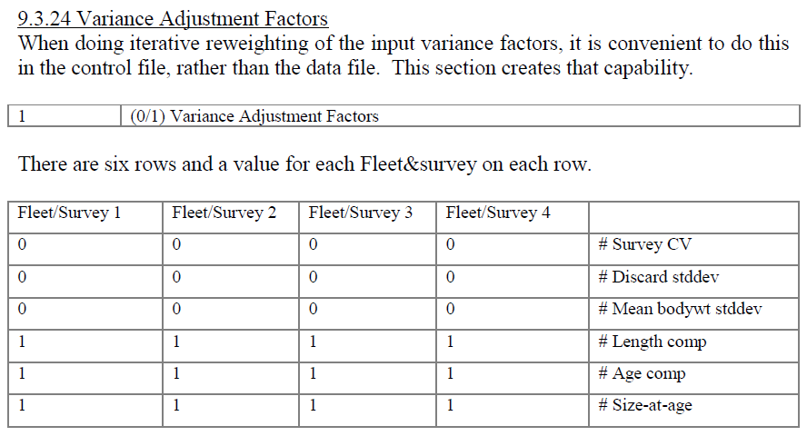
Data weighting methods in SS Variance adjustment factors

Slide 4

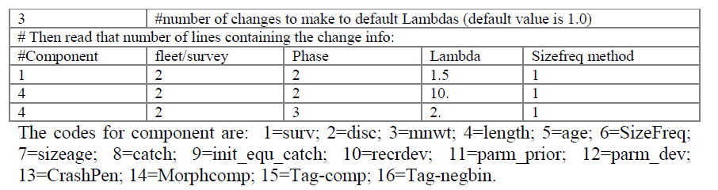
Data weighting methods in SS Lambdas

Slide 5
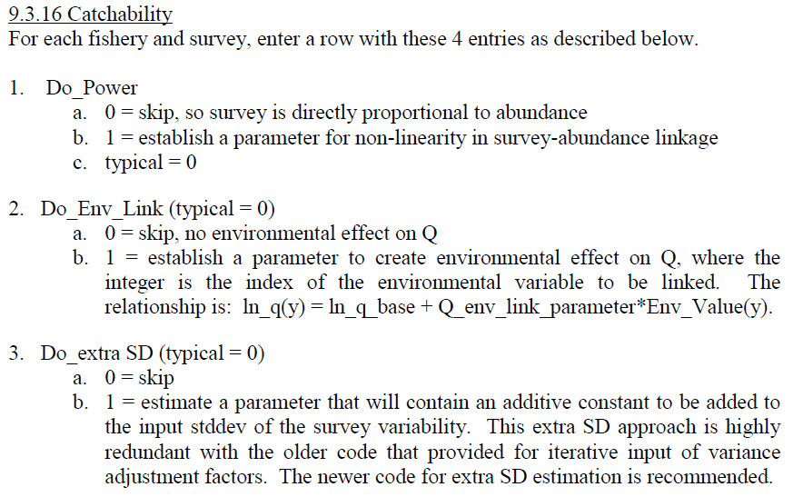
Data weighting methods Extra SD on indices of abundance

Slide 6
Data weighting guidance
Additive SD estimated for indices
Three methods guided weighting of length and age data
Multiply input N’s by a factor so that harmonic mean of effective N matches the mean of the input N
By eye, fit a line through the scatterplot of the effective N vs. the input N
Adjust input N so that variation around the mean contains the observed mean (Francis weighting)

Slide 7
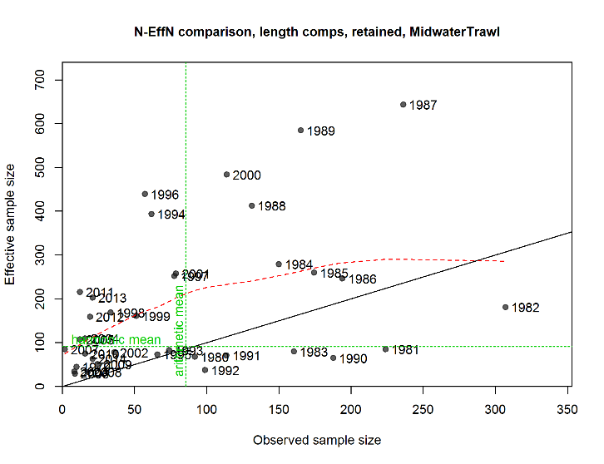
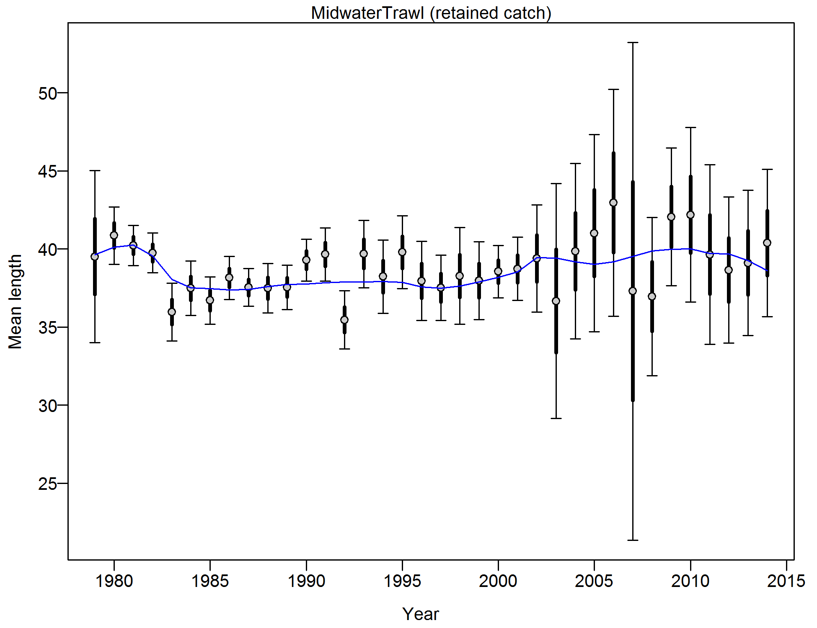
Length composition weighting
Midwater Trawl
Adj | mean (inputN*Adj) | meanEffN | HarMean (effN)
0.25 | 85.35 | 183.36 | 90.53
MeaneffN/ MeaninputN | HarMeanEffN/ MeanInputN | Francis
2.15 | 1.06 | 0.19 (0.1-0.4)

Slide 8
Fits to composition data

Slide 9
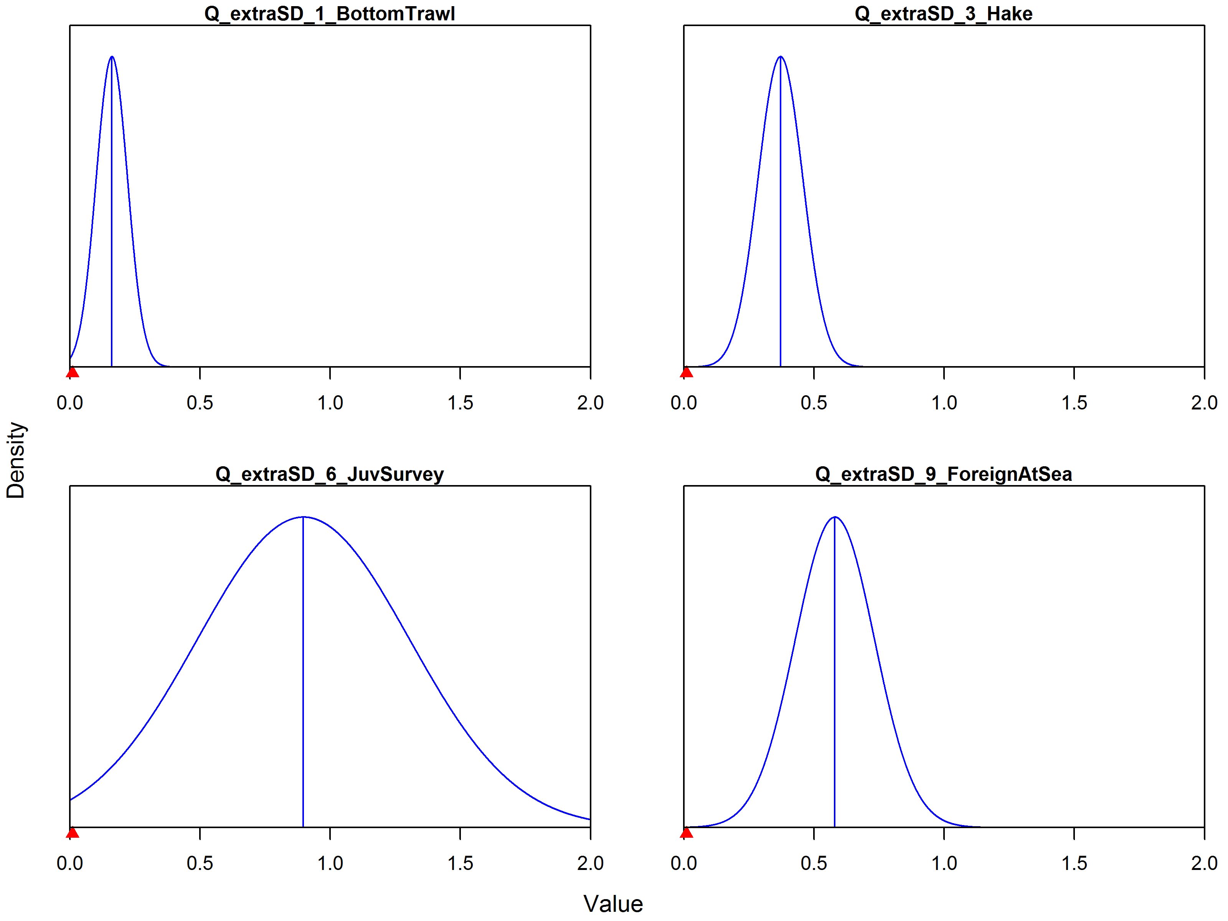
Extra SD for indices
Trawl surveys fixed at zero because estimates at lower bound

Slide 10
Final thoughts
Data weighting is an art
It is basically trying to make the residuals (or lack of fit) consistent
Don’t want standardized residuals much greater than 2 standard deviations
Can look at residuals plots to see this
These values do not need to be exact
You may want to down-weight (or up-weight) some data sources based on your belief
Not related to the guidance above

